Slide 1
Hydrology related documents
Pre INFCOM-3 Information Session
(25 March 2024)
D. Berod/Head of Division

Slide 2
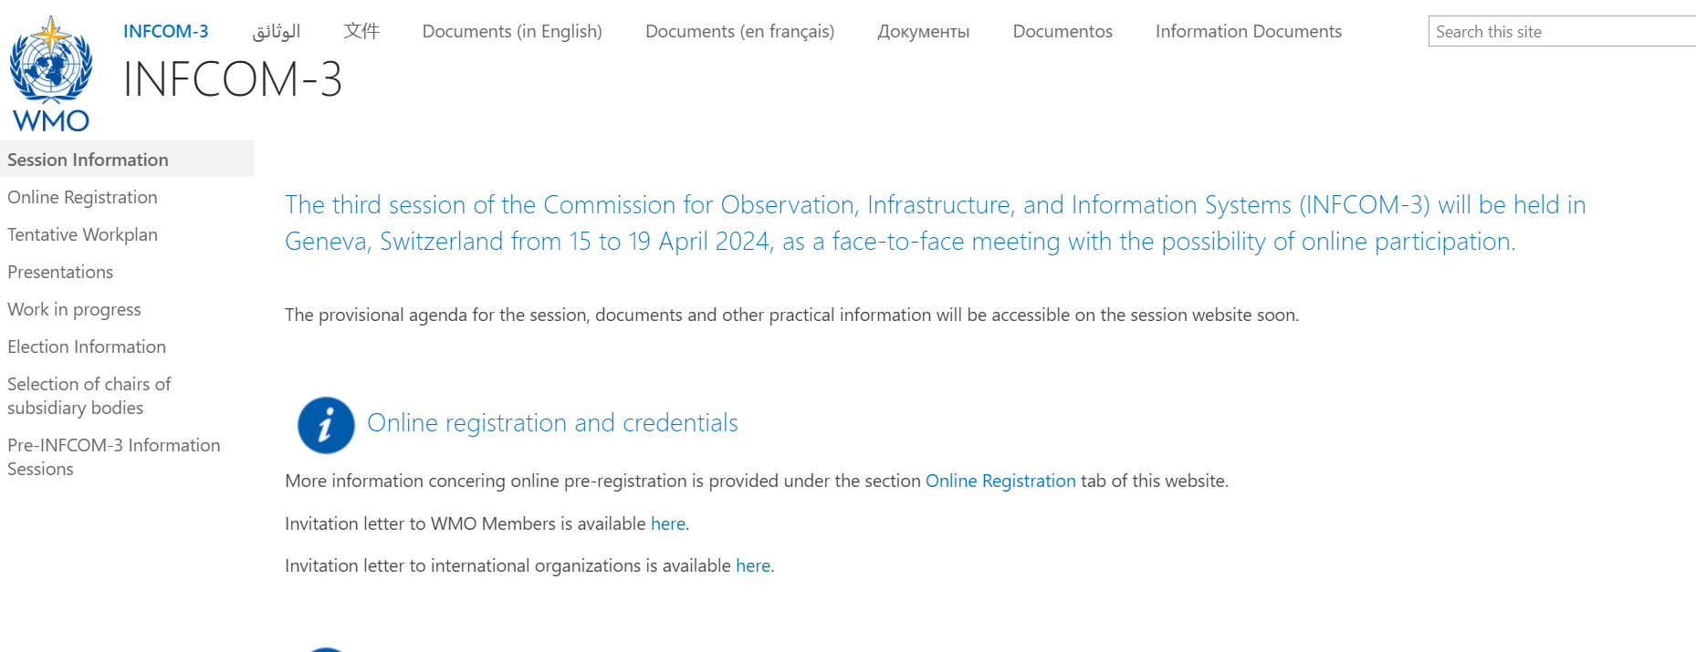
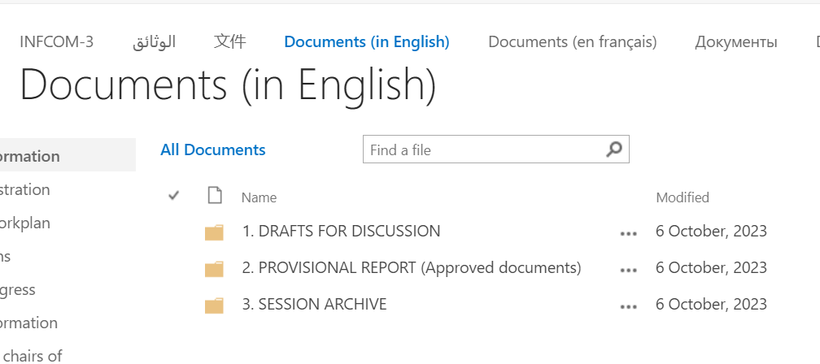
Location of documents
https://meetings.wmo.int/INFCOM-3/
Decisions
Informations

Slide 3
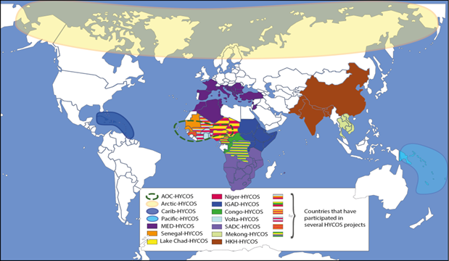
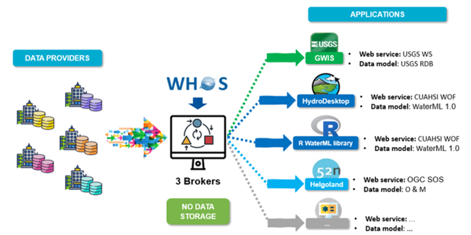
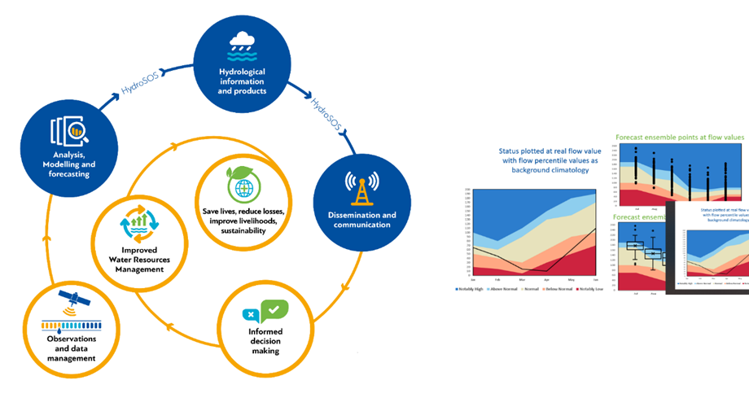
Hydrology monitoring as cross-cutting activity…
Data collection: WHYCOS, HydroHub and Project X
Data access and sharing: WHOS (tech) and WWDI (policy)
Data analysis: HydroSOS

Slide 4
Hydrology monitoring as cross-cutting activity…
Data collection: WHYCOS, HydroHub and Project X
Data access and sharing: WHOS (tech) and WWDI (policy)
WIS 2.0: SC-IMT
WIGOS : SC-ON and SC-MINT
WIPPS: SC-ESMP
Data analysis: HydroSOS
SERCOM : SC-HYD

Slide 5
Major future developments
GBON expansion to hydrological variables: GNWP, Climate modeling
Towards global hydrological networks?
Overall Earth System Approach for tangible outcomes, e.g., EW4ALL
Data policy implementation
Agreement on core and recommended data
advocacy and outreach on top of standards and technical solutions
Modernization of technical regulations
Network design at national/regional scales
Update of WMO Guide to Hydrological Practices (vol. 168), including innovative approaches
Support to Members through projects
Accelerating WHYCOS and HydroSOS, connection to CREWS and EW4ALL
Capacity building and training at all levels, from field to decision

Slide 6
Decisions submitted to INFCOM-3
Strategical level:
Recommendation from Task Team Hydrology on how better integrating hydrology within INFCOM:
INFCOM-3-d08-5(3)-TT-HYDROLOGY-RECOMMENDATIONS-draft1_en and
INFCOM-3-INF08-5(3)-TT-HYDROLOGY-RECOMMENDATIONS_en
Operational level:
Better integration of global hydrological data centers:
INFCOM-3-d08-1(6)-HYDROLOGICAL-DATA-CENTRES-draft1_en and
INFCOM-3-INF08-1(6)-REPORT-ON-HYDROLOGICAL-DATA-CENTRES_en
Technical level:
Adding a new section to the Guide to Hydrological Practices (WMO-No. 168) on Image-based methods for discharge measurement.
INFCOM-3-d08-2(4)-HYDROLOGICAL-PRACTICES-GUIDE-UPDATE-draft1_en

Slide 7
Recommendations from Task Team Hydro
Interdisciplinary group established Summer 2023, broad representation
4 online meetings, virtual brainstorms
Focus on structure and integration
DOC with Decision and TT Hydro report with 8 recommendations
INF doc with fully analysis and suggested additional tracks to explore

Slide 8
Main recommendations
Establishing an Advisory Group on Hydrology
Co-design of INFCOM goals and activities with all communities
Communication material
INFCOM to invite PR to nominate Hydro experts for work and events
SCs encouraged to secure hydro experts at SC level
JET-HYDMON to be disbanded, all technical hydrological activities under ETs or TTS from SCs.
To disband TT Hydro
Tool development to monitor success of AG Hydrology

Slide 9
Suggested structure
INFCOM MG
Coordination and value chain
AG-HYDRO
JET- HYDMON
Technical work (Project X, innovation, sediment, …)
ET-H1
ET-H2
SC-MINT
SC-ON
SC-IMT
SC-ESMP
Technical work (WHYCOS, HydroHub, HydroSOS, RRR, … )
SG 1
Technical work (WHOS )
ET-H3
ET-H4
Technical work (HydroSOS, …)
(note: there already are an Advisory group on GCW and one on Ocean)

Slide 10
Term of References (TORs) of AG Hydrology (1/2)
Is under INFCOM Management Group
Similar TORs for all Advisory Groups (with specific points though)
Coordination, advice, advocacy, no technical work
Up to 15 experts, less would be better.
Term of references:
Act as the entry point for hydrological observing infrastructure, data and information systems and predictions, including advocacy for Earth System approach benefits and increased expert participation;
Advise the management group on hydrological monitoring related matters by translating the needs from and for the hydrological community, gathered through the Hydrological Coordination Panel (HCP), into suggested activities of INFCOM bodies;
(c) Oversee, coordinate and monitor the implementation of the infrastructure aspect of the Plan of Action for Hydrology, in coordination with Hydrological Coordination Panel;

Slide 11
TORs of AG Hydrology (1/2)
Advise the management group and standing committees on the optimal working structure and engagement of domain experts to address specific deliverables required by the Plan of Action, promoting the integration of observing systems, data exchange and management and prediction functions into WIGOS, WIS and WIPPS, while ensuring the necessary coordination within domain experts;
Advise the management group and assist the vice-president representing the domain on engagement, through HCP, with the regional associations, the Services Commission, and relevant external partners to share information on requirements, workplans, and deliveries to preserve the value cycle in specific infrastructure components of the hydrological domain;
(f) Work with the Panel on Capacity Development of the Executive Council, through the Coordinator on Capacity Development, on capacity development including training.

Slide 12
Draft decision
To approve the final report of the Task Team Hydrology (TT-Hydro) and its recommendations, noting that recommendation on establishing an Advisory Group on Hydrology is handled under draft Resolution 6.2 (INFCOM-3);
To request the Management Group of the Commission for Observation, Infrastructure and Information Systems and Standing Committees to implement relevant recommendations;
To request the president of the Commission for Observation, Infrastructure and Information Systems to consult with the president of the Commission for Weather, Climate, Hydrological, Marine and Related Environmental Services and Applications and to engage with stakeholders as needed in order to develop and implement relevant recommendations.

Slide 13
Global hydrological Data Centres
Three WMO global hydrological Data Centres, together with the GPCC (Global Precipitation Climatology Centre) are supporting WMO efforts in hydrological cycle observing systems:
Global Runoff Data Centre (GRDC):
hosted by the Federal Institute of Hydrology (BfG), Koblenz, Germany
International Groundwater Resources Assessment Centre (IGRAC)
foundation under Dutch law and a UNESCO category 2 centre
International Data Centre on Hydrology of Lakes and Reservoirs (HYDROLARE)
hosted in the State Hydrological Institute, St. Petersburg, Russian Federation
Global Precipitation Climatology Centre (GPCC)
Deutscher Wetterdienst (DWD), Offenbach, Germany
Request from Cg-17 (2015) and former Commission for Hydrology (Chy-15, 2016) to assess the centers. Request was paused due to Reform, Covid and new developments (GBON, data policy, …)
Assessment made by JET-HYDMON with representatives from all centers.

Slide 14
Assessment: SWOT Analysis
For all global data centres, the main opportunities within WMO mandate are the new WMO Unified Data Policy, GBON expansion, the action plan for Hydrology, and growing awareness on needs for trusted data. Common threat for all global data centres that numerous (new and private) actors, including Google, are in the landscape.
 | IGRAC | GPCC | GRDC | HYDROLARE
Strength | - Strong support from Dutch Government and linkages to IHE Delft - UNESCO category 2 Centre - Open-source data management system - Data dissemination through web-publication - Own groundwater research activities | - Strong support from DWD - Connections to GCOS and WCRP - Worlds' largest database for QC precipitation data - Large number of data providers - Long-term time series for climate change studies - Historical and real time data - Data publication via download gate | - Long established "institution", well supported by German Government - Long-term time series for hydroclimate studies - Strong connections with different data providers - Large number and wide range of users - New Data Management System since 2017 - Data available in various formats - Active participation in various WMO programs - Is a global reference for runoff data | - Strong commitment from the Russian Institute for Hydrology - Strong cooperation with the Laboratory for Geophysical Ocean Research (LEGOS)
Weaknesses | - Connections to WMO data activities to be reinforced - No own QA/QC system but QA/QC checked with data providers | - Number of users not known | - Lack support in engaging with providers for data acquisition | - Limited resources - Not many users nor providers identified - Limited data access - No QA/QC done within the centre; data providers responsible for QA/QC
Opportunities | - New WMO action plan for hydrology can be used to reinforce contribution to WMO programmes related to groundwater activities - UNEP’s WWQA can provide a new framework for groundwater quality data management | - WMO research strategy for hydrology and HydroSOS implementation can bring a new momentum to data gathering | - WMO Unified Data Policy, WHOS and HydroSOS implementation as well as growing need for data rescue can bring a new momentum to data gathering - Stronger connections with the climate community through long-term time series for climate change studies - UNEP’s WWQA can provide a new framework for river water quality data management | - Creating synergies through stronger connection with other data centres (data management platform, data requisition, exchange standards) - Connection with WHOS and HydroSOS for data access - Cooperation with UNEP’s WWQA to establish a new framework for lake water quality data management
Threats | - Lack of support from international community limits development capacities | - Decreasing number of countries reporting data | - Countries become reluctant to report data | - Stagnant number of users and providers - Other actors are providing data on lakes (e.g., UNEP).

Slide 15
Recommendations – Highlight of possible functionalities of centres:
Gathering and Storage of data, Global quality assessment, (Joined) Distribution of data, data rescue
Advocacy for water monitoring
Contribution to HydroSOS, to global reports and water status assessments
Trainings
Strengthening links with the satellite community
Support WMO Integrated Global Observing System (WIGOS) and the Observing Systems Capability Analysis and Review tool (OSCAR) and WIPPS
No final recommendation on integration yet.

Slide 16
Draft decision
(1) To develop, in cooperation with the WMO Global Hydrological Data Centres (…), a detailed workplan, based on the report “Assessment and future roles of WMO Hydrological Global Data Centres” (INFCOM-3/INF. 8.1(6)).
Priority will be given to the following objectives:
(a) Improving interoperability and integration between data set and product, to allow an integrated water-cycle approach;
(b) Acting as data backup for those NHSs and other organizations that do not yet have their own data backup system in place;
(c) Collaborating with the Global Environmental Monitoring System (GEMS) Water Programme to allow an integrated water quality/water quantity approach to global data collection and product dissemination;
(d) Providing input to HydroSOS and to the State of Global Water Resources reports;
(e) Support the WMO training programme on data collection, management, and QA/QC.
The draft plan will be submitted to the Commission for approval at its fourth session in 2026;
(2) To foster Members’ regular submission of historical and, when feasible, near-real time data to these centres through the development of necessary technical standards.
Adding other centers, e.g., International Soil Moisture Network ?

Slide 17
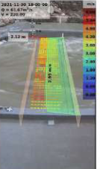
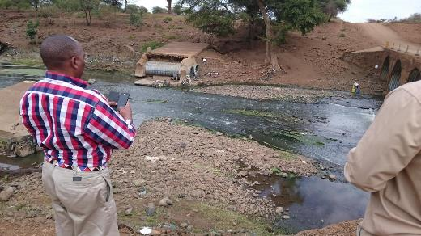
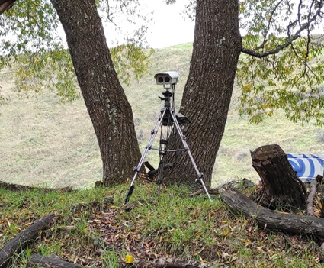
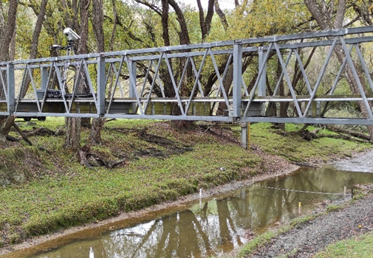
UPDATE OF THE GUIDE TO HYDROLOGICAL PRACTICES, VOLUME I (WMO-NO. 168)
Update of The Guide To Hydrological Practices, Volume I (WMO-no. 168: Hydrology – From Measurement to Hydrological Information)
Adding newest measurement technology to the WMO practices
Collaboration between the HydroHub (Innovation in hydrometry, funded by Swiss Development and Cooperation agency) and the SC-MINT Project for the Assessment of the Performance of Flow Measurement Instruments and Techniques
Image-based methods for discharge measurement: Particle Image Velocimetry (recorded video of a river section, tracking visible patterns, compute velocity and discharge)
More and more used around the world

Slide 18
UPDATE OF THE GUIDE TO HYDROLOGICAL PRACTICES, VOLUME I (WMO-NO. 168)
Draft decision:
Adopts the proposed updates to the Guide to Hydrological Practices, Volume I (WMO-No. 168) new section 5.3.7.6 - Image-based methods for discharge measurement, as provided in the annex to the present decision;
Requests its Standing Committees to periodically review the Guide, for the areas of their competence and mandate, and in cooperation with SERCOM, and update it as necessary.

Slide 19
Conclusions
Hydrology is starting a new journey for better effectivity and better integration into the WMO landscape, to better serve Members and partners.
This will help to modernize processes and knowledge for, e.g., EW4ALL, climate resilience
Working closely with HCP and SC-HYD from SERCOM
Those decisions are an important step forward
New forces are necessary: experts are most wanted to join the expert pool and different bodies.

Slide 20
Any questions to dberod@wmo.int Thank you.
^{wmo.int}

